Slide 1
Chapter 20 The Mutual Fund Industry

Slide 2
Financial System Overview (2)
Financial Markets
Financial Institutions
Bond Market (3,5,12)
Stock Market (13,6)
Money Market (11)
Mortgage Market (14)
Why Exists (7)
Banking Industry (19)
Mutual Fund Industry(20)
Hedging with Financial Derivatives (24)

Slide 3
Chapter Outline
Topics include:
The Growth of Mutual Funds
Mutual Fund Structure
Investment Objective Classes
Fee Structure of Investment Funds
Regulation of Mutual Funds
Hedge Funds
Conflicts of Interest in the Mutual Fund Industry

Slide 4
Mutual Funds
Suppose you wanted to start savings for retirement, but you can only afford to invest $100 / month. How do you develop a diversified portfolio?
Mutual funds are one potential answer.
Mutual funds pool the resources of many small investors by selling them shares and using the proceeds to buy securities.

Slide 5
The Growth of Mutual Funds
The Growth of Mutual Funds: mutual funds growth has been dramatic, increasing from under $300 billion in 1980 to over $16 trillion in 2016.
At the beginning of 2016, 54% of retirement assets were held by mutual funds.
31% of the U.S. stock market and almost 43% of all U.S. households hold stock via mutual funds.
Assets held by mutual funds have grown by about 17% per year for the last 25 years, reaching over $16 trillion.

Slide 6
The Growth of Mutual Funds
The origins of mutual funds can be traced back to the mid to late 1800s in England and Scotland.
The first mutual fund similar to the funds of today was introduced in Boston in 1824.
The stock market crash of 1929 set the mutual fund industry back because small investors avoid stocks and distrusted mutual funds.
The Investment Company Act of 1940 reinvigorated the industry by requiring better disclosure of fees, etc.

Slide 7
Five principal benefits of mutual funds
Liquidity intermediation: investors can quickly convert investments into cash and at a low cost.
Denomination intermediation: investors can participate in equity and debt offerings that, individually, require more capital than they possess.
Diversification: investors immediately realize the benefits of diversification even for small investments.
Cost advantages: the mutual fund can negotiate lower transaction fees than would be available to the individual investor.
Managerial expertise: many investors prefer to rely on professional money managers to select their investments.

Slide 8
The Growth of Mutual Funds
Ownership in mutual funds has changed dramatically over the last 20 years
In 1980, only 5.7% of households held mutual fund shares
In the beginning of 2015, that number was 44%
89% of mutual fund shares were owned by households.
Mutual funds account for $7.1 trillion, or 30% of the retirement market.

Slide 9
http://www.icifactbook.org/data/16_fb_data

Slide 10
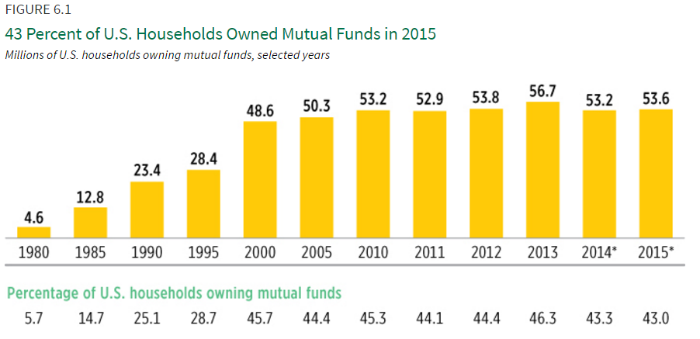
http://www.icifactbook.org/ch6/16_fb_ch6

Slide 11
Chapter Outline
Topics include:
The Growth of Mutual Funds
Mutual Fund Structure
Investment Objective Classes
Fee Structure of Investment Funds
Regulation of Mutual Funds
Hedge Funds
Conflicts of Interest in the Mutual Fund Industry

Slide 12
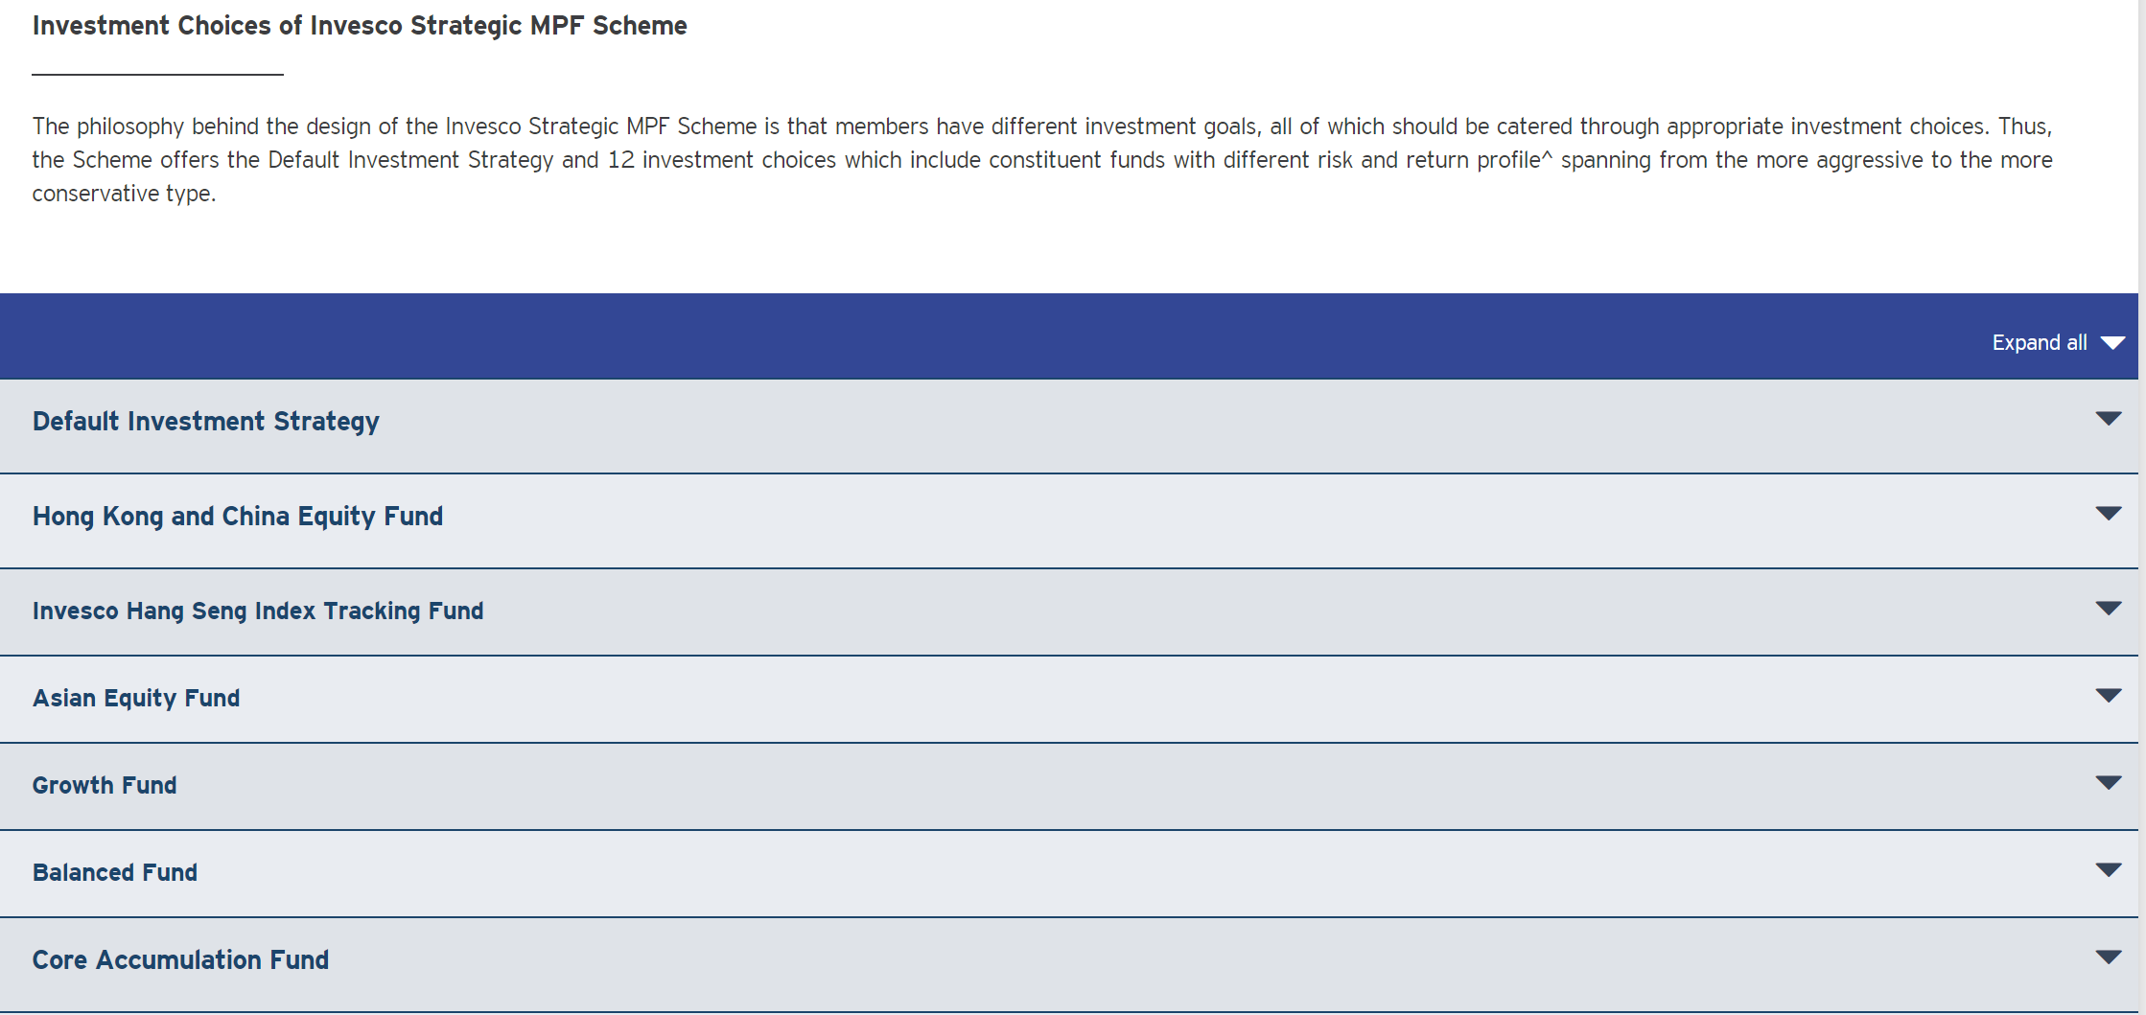
Mutual Fund Structure
Investment companies usually offer a number of different types of mutual funds, they are called complexes.
Investors can often move investments among these funds without penalty.
The complexes often issue consolidated statements.

Slide 13
Mutual Fund Structure
Closed-End Fund: a fixed number of nonredeemable shares are sold through an initial offering and are then traded in the OTC market.
Price for the shares is determined by supply and demand forces.
fluctuates with the value of the assets held by the funds.
may be above or below the value of the assets held by the fund, depending on the market’s assessment of how likely managers are to pick stocks that will increase fund value.
Problem: Once shares have been sold, the fund cannot take in any more investment dollars.
Advantage: investors cannot make withdrawals.

Slide 14
Mutual Fund Structure
Open-End Fund: investors may buy or redeem shares at any point, where the price is determined by the net asset value of the fund.
The number of shares outstanding will change.
All shares bought and sold that day are traded at the same net asset value.
Couple of advantages:
The investment is very liquidity
Allows mutual funds to grow unchecked.

Slide 15
Calculating a Mutual Fund’s Net Asset Value
Net Asset Value (NAV)
Definition: Total value of the mutual fund’s stocks, bonds, cash, and other assets minus any liabilities such as accrued fees, divided by the number of shares outstanding

Slide 16
Mutual Fund Structure: the Organization
The shareholders, or owners, of the mutual fund are the investors.
The board of directors oversees the fund’s activities, hires the investment advisor, an underwriter, etc., to manage the day to day operations of the fund.
In theory, the board can fire the fund manager and hire anyone they choose.

Slide 17
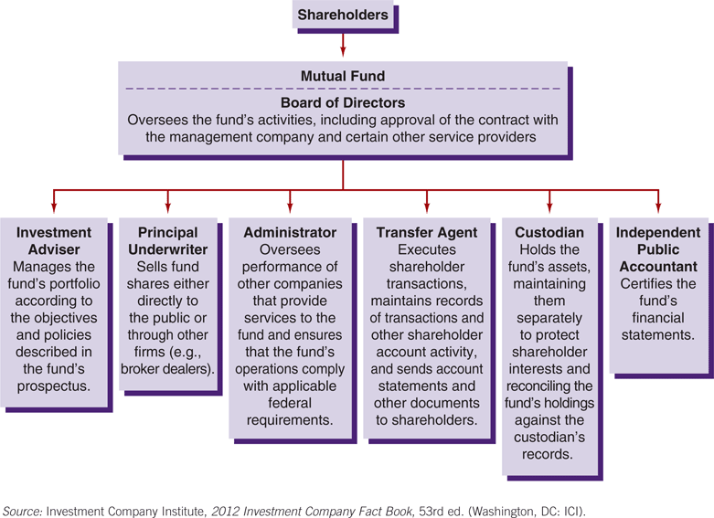
Figure 20.3 The Organizational Structure of a Mutual Fund

Slide 18
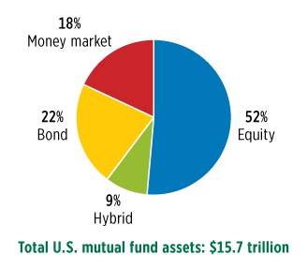
Investment Objective Classes
There are four primary classes of mutual funds available to investors:
Stock (equity) funds
Bond funds
Hybrid funds
Money market funds
http://www.icifactbook.org/ch2/16_fb_ch2

Slide 19
Investment Objective Classes -Stock Funds
Other than investing in common equity, the stated objective of any particular fund can vary dramatically.
Capital Appreciation Funds seek rapid increase in share price, not being concerned about dividends, the largest one (44%), mainly invest in high-tech and internet firms.
Total Return Funds seek a balance of current income and capital appreciation (29%).
World Equity Funds invest primarily in foreign firms.
Other types in Value, Growth, a particular industry, etc.

Slide 20
Investment Objective Classes - Bond Funds
Investment Grade funds invest in high-quality, relatively low-risk securities.
These will typically be high-grade bonds offered by large corporations.
The quality of these investments will be high, but the returns may be lower.
Investors are trading safety for greater returns.
Government Bond Funds invest in U.S. Treasury, as well as state and local government bonds.
default risk-free but have relatively low returns.
Others include World Bond Funds, etc.

Slide 21
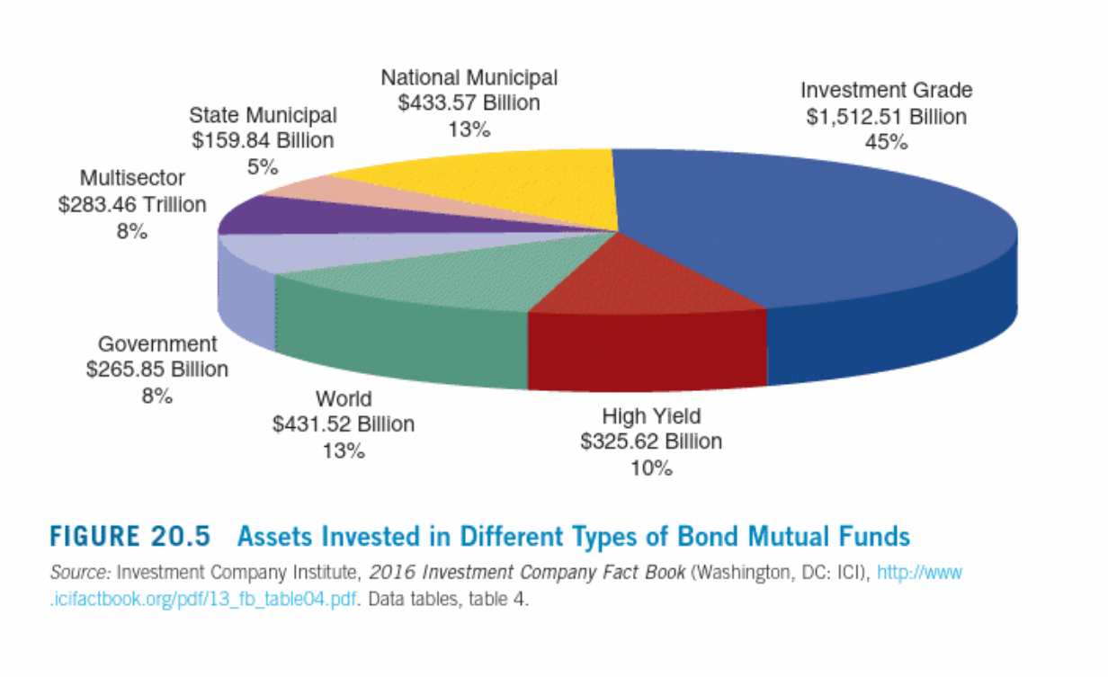
Figure 20.5 Assets Invested in Different Types of Bond Mutual Funds

Slide 22
Investment Objective Classes
Hybrid Funds
Combine stocks and bonds into a single fund.
Account for about 7% of all mutual fund accounts.
Money Market Mutual Funds
Open-end funds that invest only in money market securities.
Offer check-writing privileges.
Most funds do not charge investors any fee for purchasing or redeeming shares.
Although money market mutual funds offer higher returns than bank deposits, the funds are not federally insured.

Slide 23
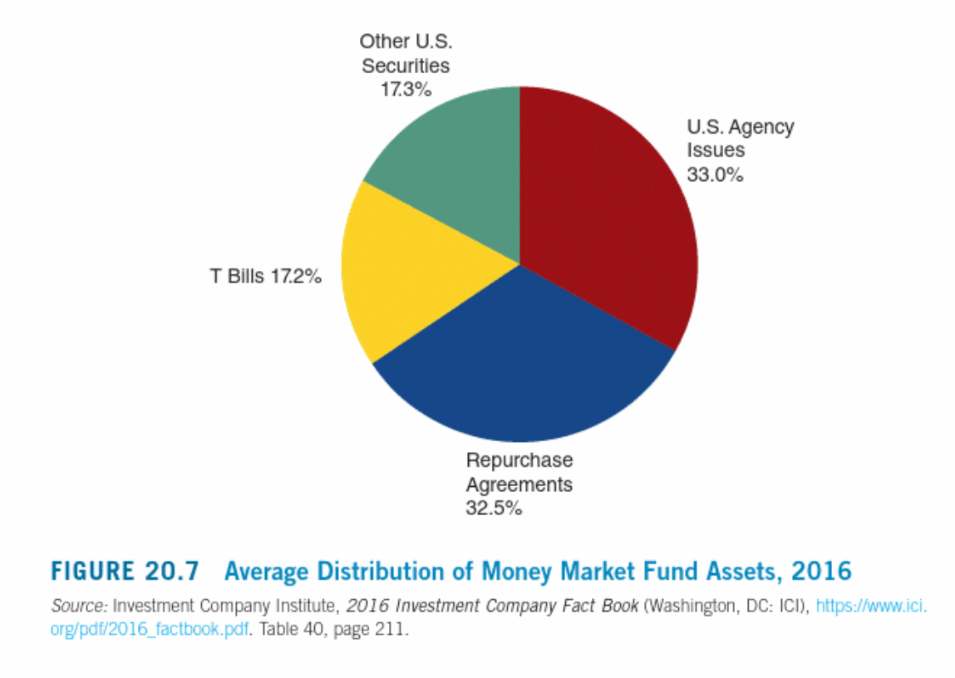
Investment Objective Classes

Slide 24
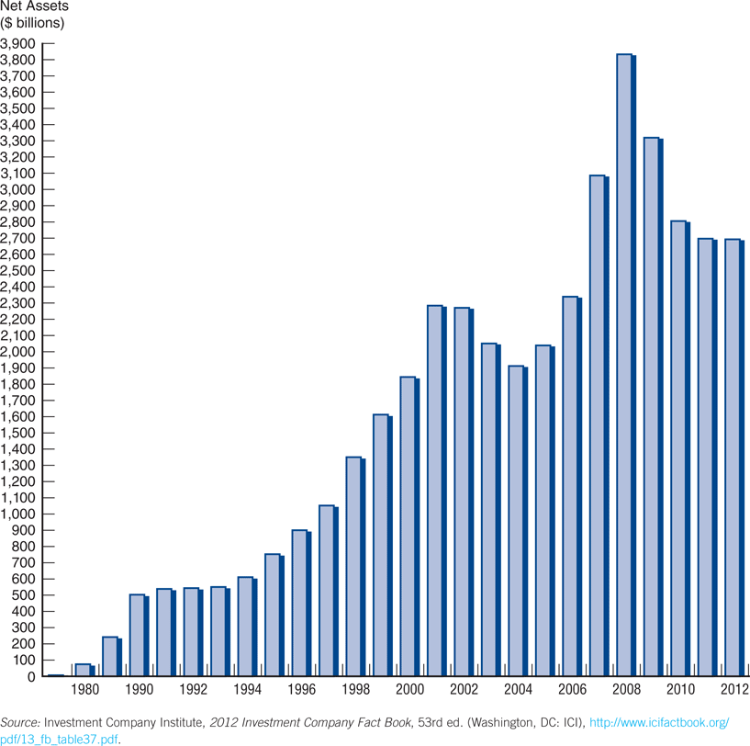
Figure 20.6 Net Assets of Money Market Mutual Funds

Slide 25
Investment Objective Classes
Index Funds
A special class of mutual funds that do fit into any of the categories discussed so far.
The fund contains the stock of the index it is mimicking. For example, an S&P 500 index fund would hold the equities comprising the S&P 500.
Offers benefits of traditional mutual funds without the fees of the professional money manager.

Slide 26
Chapter Outline
Topics include:
The Growth of Mutual Funds
Mutual Fund Structure
Investment Objective Classes
Fee Structure of Investment Funds
Regulation of Mutual Funds
Hedge Funds
Conflicts of Interest in the Mutual Fund Industry

Slide 27
Fee Structure of Investment Funds
Most shares of mutual funds were sold by brokers who received a commission for their efforts.
Load funds (class A shares) charge an upfront fee for buying the shares (1%, 2%, or even 6%)
Deferred load (class B shares) funds charge a fee when the shares are redeemed, usually a declining fee over five years.
No-load funds: if the particular fund charges no front or back end fees, it is referred to as class C shares.

Slide 28
Other fees charges by mutual funds
contingent deferred sales charge: imposed at the time of redemption is an alternative way to compensate financial professionals for their services. This fee typically applies for the first few years of ownership and then disappears.
redemption fee: another name for a back end load
exchange fee: a fee (usually low) for transferring money between funds in the same family.
account maintenance fee: charges if the account balance is too low.
12b-1 fee: fee to pay marketing, advertising, and commissions. By law, this fee cannot exceed 1% per year.
These fees can range from 0.25% to 8% per year. No research supports the argument that investors get better returns by investing in funds that charge higher fees.

Slide 29
Regulation of Mutual Funds
Mutual funds are regulated by four primary laws:
Securities Act of 1933: specifies disclosure requirements
Securities Exchange Act of 1934: details antifraud rules
Investment Company Act of 1940: requires registration and minimal operating standards
Investment Advisors Act of 1940: regulates fund advisors
All funds must provide two type of documents free of charge: a prospectus and a shareholder report.

Slide 30
Regulation of Mutual Funds
Mutual funds are the only companies in the U.S. that are required by law to have independent directors, as follows (2001 SEC rules)
Independent directors must constitute a majority of the board
Independent directors select and nominate other independent directors
Legal counsel to the independent directors must also be independent

Slide 31
Hedge Funds
A special type of mutual fund that received considerable attention following the collapse of Long Term Capital Management.
Different from typical mutual funds, as follows:
High minimum investment, averaging around $1 million
Long-term commitment of funds is required
High fees: typically 1% annual asset management fee plus 20% of profits
Highly levered
Little current regulation

Slide 32
Hedge Funds
Hedge funds are often trying to take advantage of unusual spreads between security prices
For example, at LTCM, the managers noted that 29.5-year U.S. Treasury bonds seemed cheap relative to 30-year Treasury securities. The managers figured that the value of the two bonds would converge over time.
LTCM bought $2 billion of the 29.5-year bonds and sold short $2 billion of the 30-year bonds. The net investment by LTCM was $12 million. Six months later, the fund reversed these transactions, and realized a $25 million profit!
In the transaction, the managers did not care whether the overall bond market rose or fell.
The transaction was market-neutral.

Slide 33
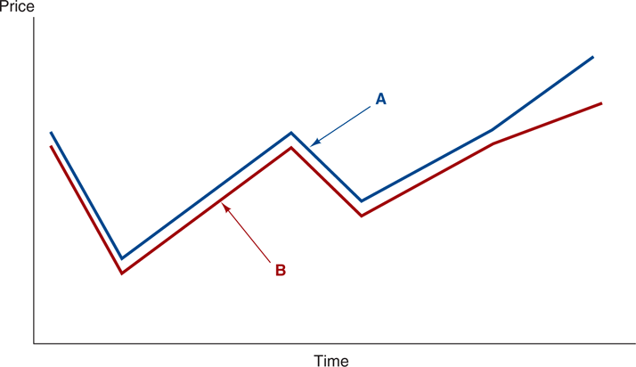
Hedge Funds
Figure 20.8 The Price of Two Similar Securities
Short A, buy B

Slide 34
ETF
Close-end Funds
Open-end Funds
Index Funds

Slide 35
Exchange-Traded Fund (ETF)
An ETF is a marketable security that tracks an index, a commodity, bonds, or a basket of assets like an index fund.
Unlike mutual funds, an ETF trades like a common stock on a stock exchange.
ETFs experience price changes throughout the day as they are bought and sold.
Because it trades like a stock, an ETF does not have its net asset value (NAV) calculated once at the end of every day like a mutual fund does.

Slide 36
Arbitrage
Since both the ETF and the basket of underlying assets are tradeable throughout the day, traders take advantage of momentary arbitrage opportunities, which keeps the ETF price close it its fair value.
If a trader can buy the ETF for effectively less than the underlying securities, they will buy the ETF shares and sell the underlying portfolio, locking in the differential.

Slide 37
Arbitrage
Stock net value 15
ETF price 20
Buy stocks at 15
Create new ETF units
Sell new ETF units at 20 in market
Demand for stock increase (price increase)
ETF supply increase (price drop)
Difference narrow to no arbitrage profit
ETF price 15
Stock net value 20
Redeem ETF at 15
Get corresponding stocks
Sell stocks at 20 in the market
ETF supply decrease (price increase)
Stock supply increase (price drop)
Difference narrow to no arbitrage profit

Slide 38
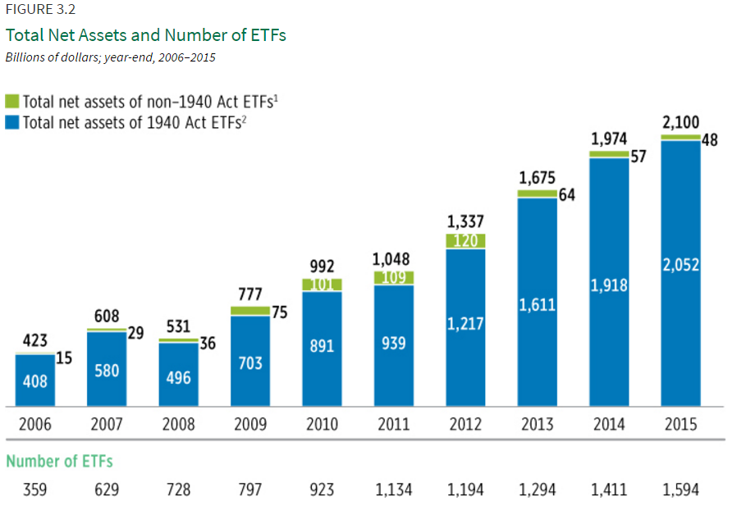
http://www.icifactbook.org/

Slide 39
Conflicts of Interest in the Mutual Fund Industry
Investor confidence in the stability and integrity of the mutual fund industry is critical.
However, the usual problems of asymmetric information and the principal-agent problem arose, leading to abuses on the part of fund management.
Shareholders depend on directors to monitor investment advisers.
The incentive structure for compensating investment advisers does not ensure that they will be motivated to maximize shareholder wealth.
In the absence of monitoring, investment advisers will attempt to increase their own fees and income, even at the expense of shareholders.
For example, suppose an institutional investor offers to make a large deposit into the fund in exchange for special trading privileges not afforded other investors.

Slide 40
Conflicts of Interest in the Mutual Fund Industry
Mutual Fund Abuses
Late trading: allowing trades after 4:00 pm to trade at today’s 4:00 NAV instead of tomorrow’s price. This is illegal under SEC regulations.
Suppose at 4:00pm, the NAV for a technology fund is $20. Now, suppose that good news received by traders at 6:00PM. Traders may want to enter buy orders for the fund at the $20 price.
Market timing: taking advantage of time zone differences for determination of NAV. This is not illegal under SEC rulings, but is considered unethical.
For example, Japan market closes nine hours earlier. If news is released in Japan that isn’t reflected in their closing prices, arbitrage opportunities exist by buying at the stale prices embedded in the NAV.

Slide 41
One Example
Suppose a technology fund holds stock in various firms with a total current market value of $350. Further suppose you own one of 10 shares. Now, suppose that after the market closes the tech industry announces better-than-expected earnings which will drive the value of shares held by the fund to $400. The NAV of your share would be $40. However, if some investor with special privileges is allowed to buy a share in the fund for $35 after hours, your NAV will be diluted to: (400+35)/11=$39.54.
All of the original investors in the fund will have lost 0.46 per share, while the privileged investor will have gained $4.54.

Slide 42
Conflicts of Interest: Mutual Fund Lawsuits and Settlements
Alliance Capital Management Corp. was charged with allowing traders to engage in market timing, paying $250 million in fines and restitution to shareholders.
Bank of America, along with Canary Capital Partners, agreed to fee reductions of $160 million and fines and restitution of $375 million
Janus reduced fees by $125 million and pay fines and restitution of $100 million
Putnam Investments, the fifth-largest family of funds, agreed to pay $100 million in fines and restitution

Slide 43
Conflicts of Interest: SEC Survey Finds Abuses Widespread
In a sample of the largest 88 mutual fund companies, which represented 90% of the industry’s assets, the SEC said that about 25% of the broker-dealers were allowed to make illegal late trades.
Half the funds let some privileged shareholders engage in market timing trades.
Research also showed that more than 30% of the funds admitted that their managers had shared sensitive portfolio information with favored shareholders.

Slide 44
Conflicts of Interest in the Mutual Fund Industry
Government Response to Abuses
Require more independent directors
Hardening the 4:00 valuation rule: this addresses the late trading problem, but not market timing.
Increased and enforced redemption fees: fees to discourage market timing by additional fees for short-term redemptions.
Increased transparency: hits operating practices, directors, investment managers, compensation arrangements with brokers, etc.

Slide 45
Chapter Outline
Topics include:
The Growth of Mutual Funds
Mutual Fund Structure
Investment Objective Classes
Fee Structure of Investment Funds
Regulation of Mutual Funds
Hedge Funds
Conflicts of Interest in the Mutual Fund Industry

